Slide 1
Local Search

Slide 2
Classical Search
Observable
Deterministic
Known Environment
Solution of sequence of actions

Slide 3
Features of local search algorithms
They apply mostly to problems for which we don't need to know the path to the solution but only the solution itself.
They operate using a single state or a small number of states and explore the neighbors of that state. They usually don't store the path.
A particular case are optimization problems for which we search for the best solution according to an objective function.
The distribution of values of the objective function in the state space is called a landscape.
Starting from an initial solution or solutions, move through the search space to a “better” position
Often naïve, but very good way of obtaining near-optimal solutions
Very little memory – usually constant amount
Many variants:
  Hill-climbers
  Simulated annealing
  Tabu search

Slide 4
Solution Representation
A method of representing the problem
For example
  A binary string
  A permutation
  A vector of real numbers
In general, choose the most natural way of representing the problem

Slide 5
What is a neighborhood ?
The set of solutions that can be reached from a given state by applying some “move”
Small neighborhoods are cheap to explore but you might need to explore many of them
Large neighborhoods are hard to explore, but solution quality might be better
Need to find a function that strikes the right balance between complexity of search and the quality of the solution

Slide 6
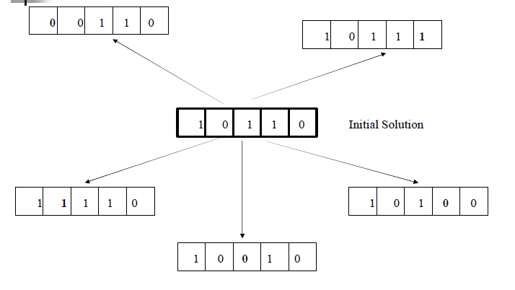
Neighborhood = “flip 1 bit”

Slide 7
Hill-climbing search
“a loop that continuously moves towards increasing value”
Hill climbing does not look ahead of the immediate neighbors
Can randomly choose among the set of best successors – if multiple have the best value

Slide 8
A Hill-climbing Algorithm
Pick a solution from the search space , x. Evaluate it.
2. Choose a solution y in the neighborhood of x. Evaluate it.
3. If y is better than x, replace x with y, else discard it.
4. Return to step 2 until some stopping criterion applies

Slide 9
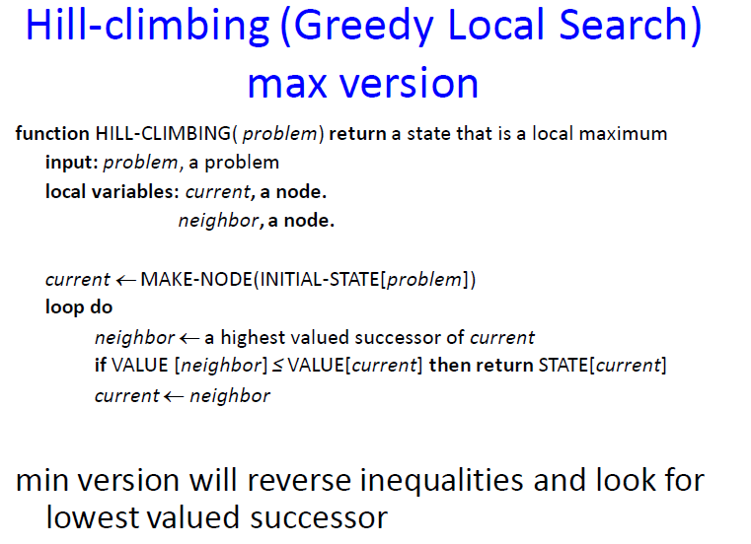

Slide 10
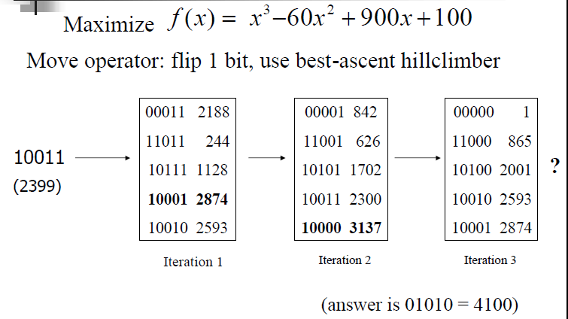
An Example

Slide 11
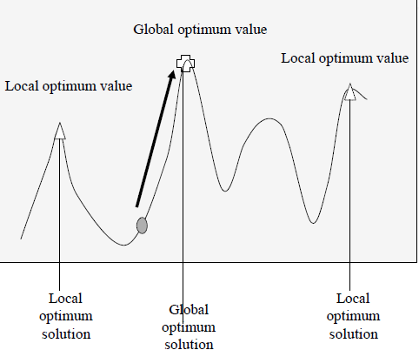
Is Hill-Climbing a Good Idea ?
However, it is very easy to implement and to give fairly good solutions very quickly.
It works well if there is not too many local optima in the search space

Slide 12
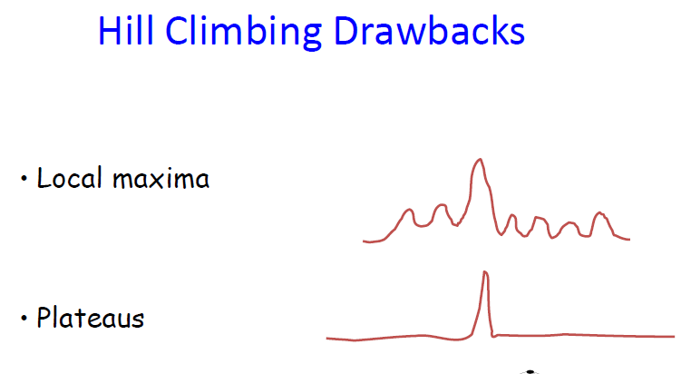

Slide 13
Simulated Annealing (SA)
SA is another local search algorithm which has proved very effective in practice
It works by searching neighborhoods via a move operator
BUT – it reduces the chance of getting stuck in a local optimum by allowing moves to inferior solutions

Slide 14
Simulated Annealing -
Background
Idea from a physical process of heating and then slowly cooling a substance to obtain a strong crystalline structure – structure depends on the rate of cooling
  Large crystals are grown from slow cooling, fast cooling results in imperfections
SA algorithm simulates the energy changes in a system subject to a cooling process until it converges to a steady ‘frozen’ state

Slide 15
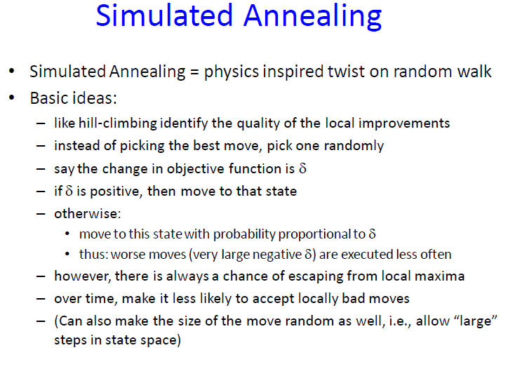

Slide 16
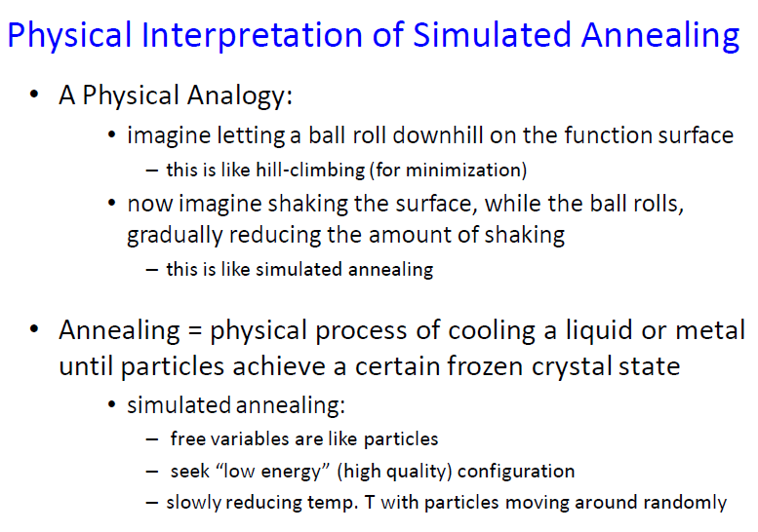

Slide 17
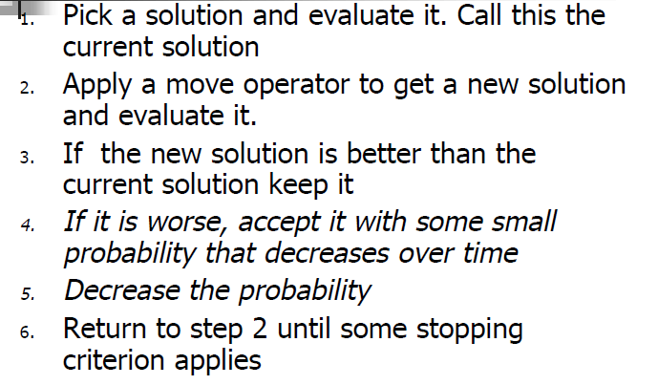
A Generic SA Algorithm

Slide 18
Deciding to accept solutions:
The probability of accepting a worse move is determined by the system temperature
At high temperatures, there is a high probability of accepting inferior moves
At low temperatures, there is a low probability of accepting inferior moves
Accepting inferior moves allows the system to escape from local optima

Slide 19
The temperature variable
The temperature decreases as the algorithm runs:
  At the beginning, high T means lots of inferior moves get accepted
  Near end, low T means hardly any bad moves get accepted
If the temperature decreases logarithmically, guarantee optimum

Slide 20
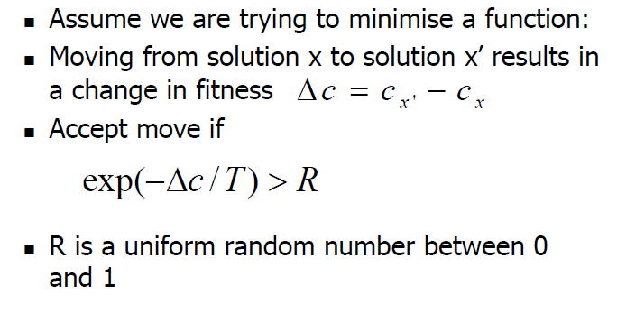
How is this implemented ?

Slide 21

SA in practice-an example
Maximise
Encode x as 5 bit string,
Neighborhood - flip 1 bit at random
Maximum is 01010 (x=10,f(x)=4100)
Start from 10011 (x=19,f(x)=2399),
with initial temperature=500

Slide 22
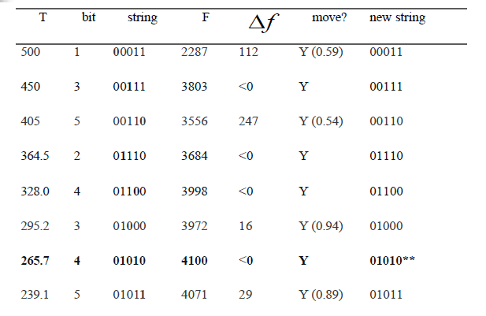
Attempt 1: T=500 (start 10011)

Slide 23
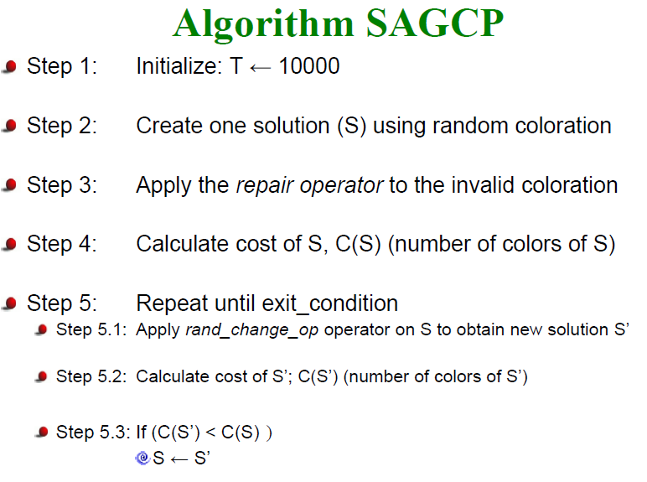

Slide 24
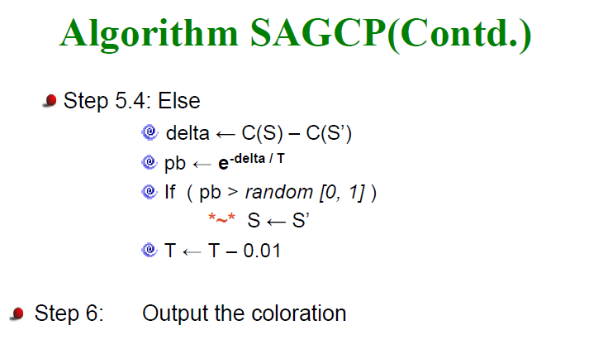

Slide 25
Advantages
Statistically guarantees finding an optimal solution
Generally gives a good solution
Can deal with arbitrary system and cost functions

Slide 26
Disadvantages
Repeated annealing process is expensive for a complex cost function
For problems where the energy landscape is smooth, then SA is overkill
Heuristic methods which are problem specific will often be better then general methods

Slide 27
Conclusions
Simulated annealing algorithms are usually better than greedy algorithms, when it comes to problems that have numerous locally optimum solutions
Simulated annealing guarantees a convergence upon running sufficiently large number of iterations

